Slide 1

Construction company Management system

Slide 2

Abstract
The Construction Company Management System (CCMS) is a comprehensive software solution designed to optimize and streamline various aspects of construction company operations, with a particular focus on efficient rental equipment management. In the construction industry, effective management of rental equipment is crucial for project success, as it directly impacts project timelines, costs, and resource allocation. The CCMS integrates key functionalities such as project planning, resource management, financial tracking, communication, and rental equipment management, providing a centralized platform for seamless project oversight.

Slide 3
Project requirements
1.Profile management
2. User registration and login
3.users can search the building plan
3. Ability to view user requirement
4. Status update for building plan
5. Add building requirements
6.Equipment rental management
7.Customer support

Slide 4

Features and Highlights
Registration forms
users and architects can register and
perform their functions.
Search
users can add their requirments
Add plans
users can search building plans
Rental equipments
architects can add their plans and works
Approve users
users to browse and rent equipment and machinery directly within the system.
Django admin
approve users and architects
Search
users can add their requirments

Slide 5


Technical Aspects
Programming languages and framework
Backend development
Python and django framework
Item 2
Front end development: HTML ,CSS, J
AVASCRIPT,
and front end framewrok BOOTSTRAP
Database management
Sqlite3

Slide 6

Libraries
Jazzmin
Django-Jazzmin is a customizable theme for the Django admin interface, which is the default administration interface that comes with Django. It offers a sleek and modern design, improved functionality, and additional features compared to the default Django admin. With Django-Jazzmin, you can customize the appearance of the admin interface, add or remove menu items, and enhance the user experience for administrators.

Slide 7
Architecture
Architecture follows a client -server model, where the client (web browser) sends requests to the server (Django application), which processes the requests, interacts with the database, and generates responses to be sent back to the client.
*Models
*Views
*Templates
*URL Configuration
*Static Files etc

Slide 8
Challenges
User interface design and usability: Designing an intuitive and user-friendly interface that accommodates different user roles and provides a smooth feedback submission experience can be challenging. Balancing the aesthetics, usability, and responsiveness of the system to cater to various devices and screen sizes can also pose difficulties.
Testing and quality assurance: Ensuring the system functions correctly, identifying and resolving bugs or issues, and ensuring the system meets the desired quality standards may pose difficulties during the project.
User-specific permissions and access control: The feedback system needed to provide different levels of access and permissions based on user roles (students, faculty). Configuring granular access control and managing permissions for different user types within the admin interface presented a challenge.

Slide 9
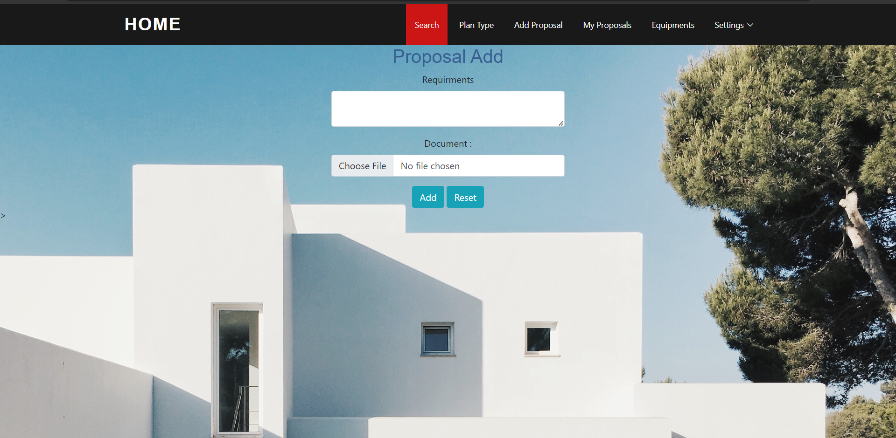
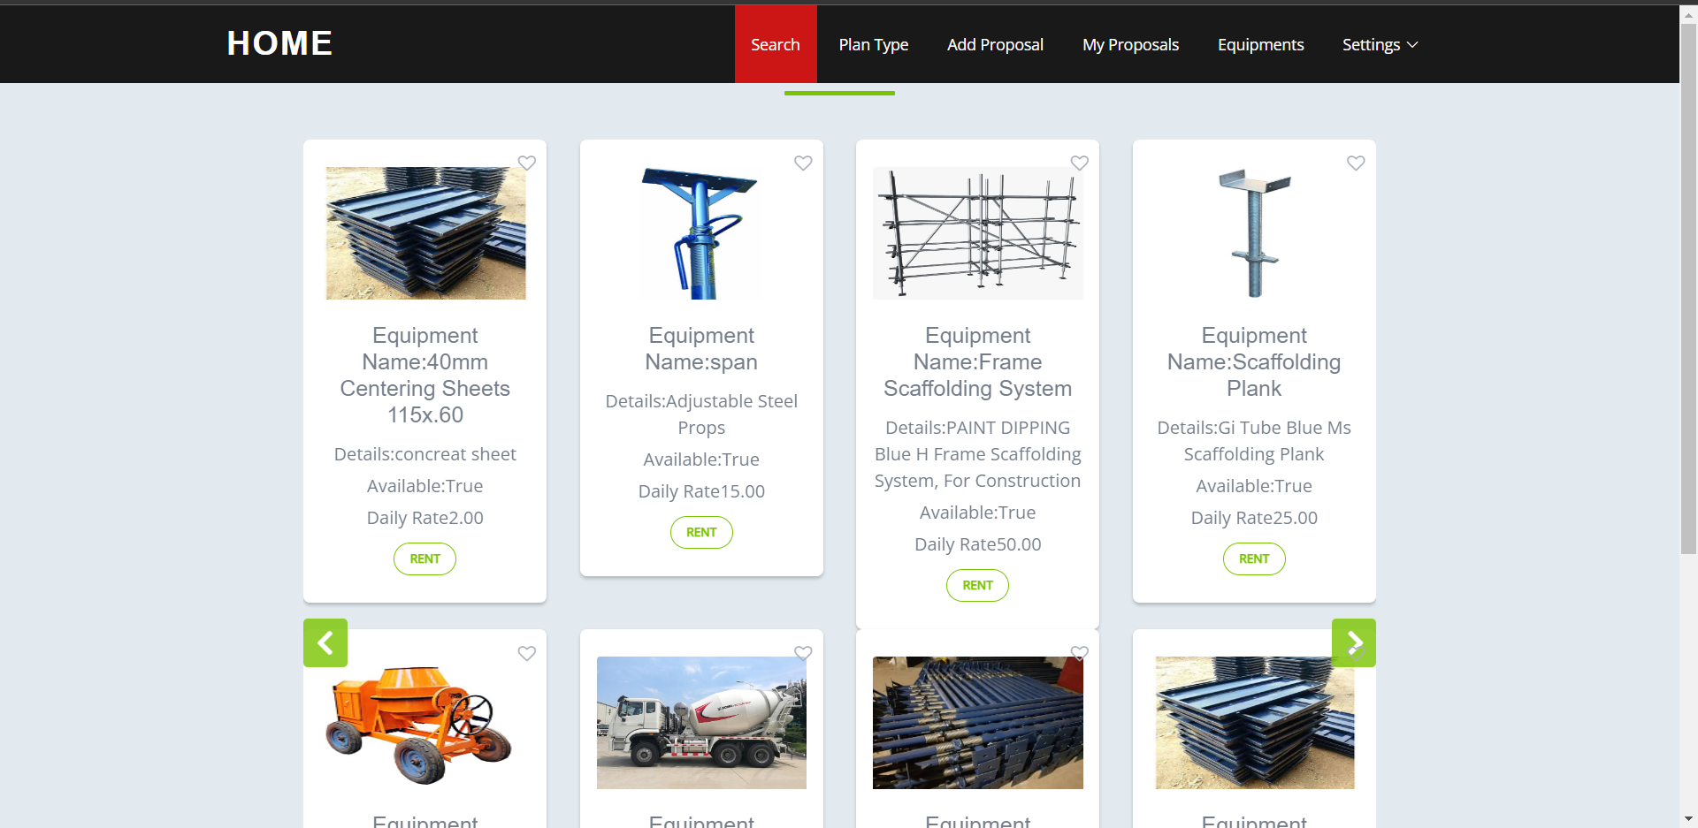
SCREENSHOTS

Slide 10
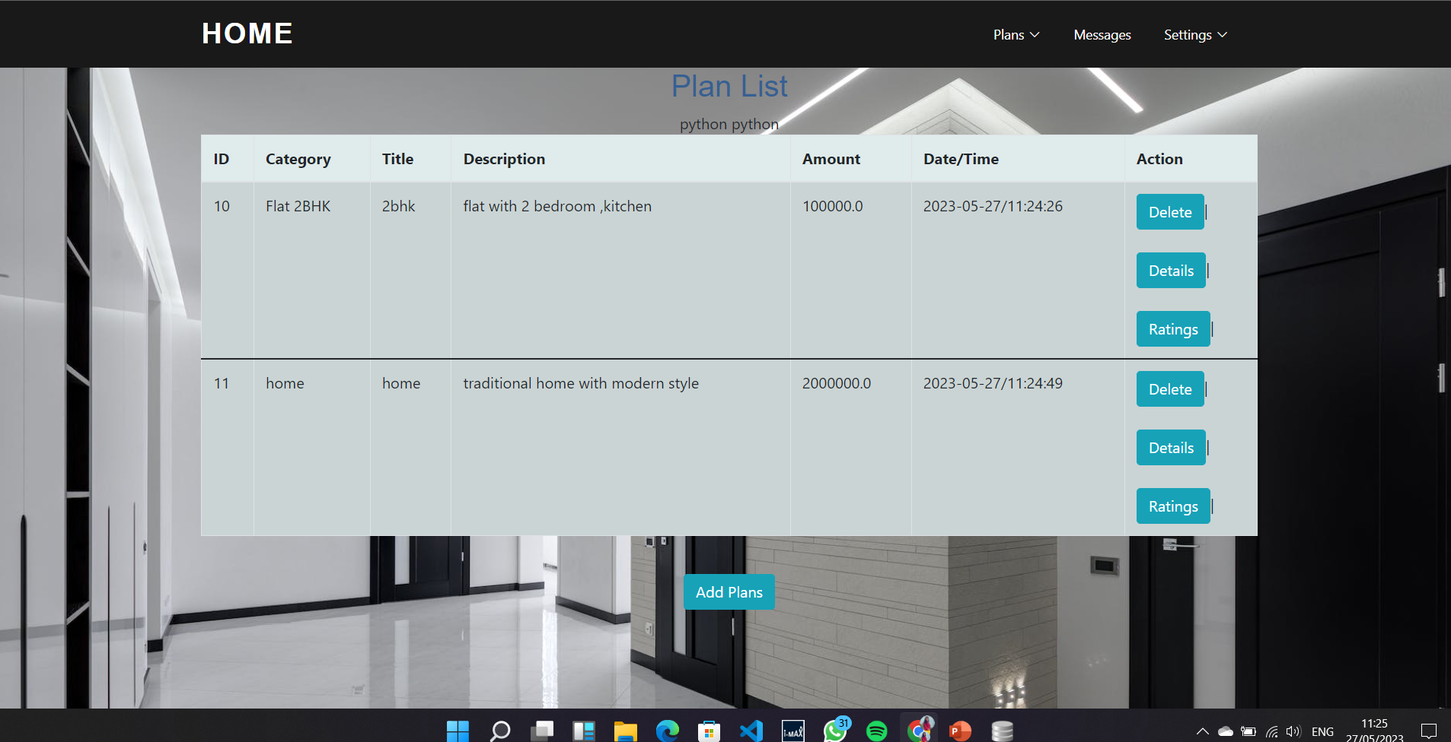
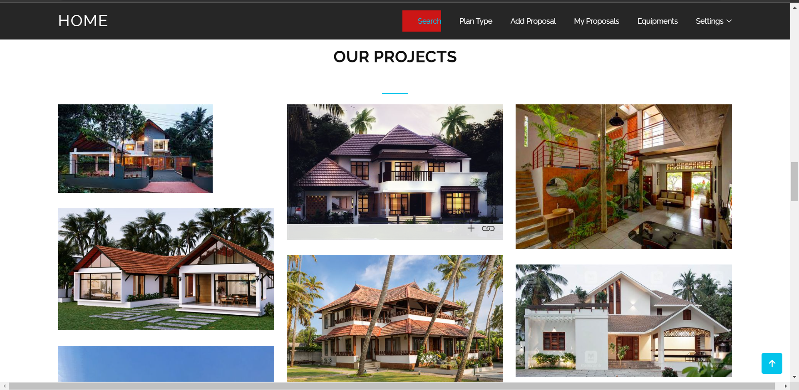
SCREENSHOTS

Slide 11
FUTURE ENHANCEMENT
3.Add labour management
2.Advanced searching and filtering
1.Notification

Slide 12
CONCLUSION
In conclusion, the Construction Company Management System (CCMS) project is a comprehensive software solution that aims to revolutionize construction company operations, with a particular emphasis on efficient rental equipment management. The CCMS integrates various functionalities, including project planning, resource management, financial tracking, communication, and rental equipment management, to streamline operations and enhance efficiency.
By implementing the CCMS, construction companies can optimize their rental equipment processes, minimize equipment downtime, control costs, and improve overall project performance. The system offers features such as equipment catalog, availability tracking, rental requests, and logistics management, providing a centralized platform for seamless equipment rental and utilization.

